Slide 1
Probability and statistics 04-Discrete Random Variable
상명대학교 휴먼지능정보공학과
2022년 2학기

Slide 2
Discrete Random Variable
A discrete sample space Ω is a countable or listable set of outcomes {ω1,ω2 ...}. The probability of an outcome ω is denoted P(ω).
An event E is a subset of Ω.
The probability of an event E is P(E)=∑_{ω∈E} P(ω).
Definition: Let Ω be a sample space. A discrete random variable is a function
X : Ω → R
that assigns a number to each outcome. (R stands for the real numbers.)
“X = a” denotes the event {ω | X(ω)= a}.
Why is X called a random variable? It’s ‘random’ because its value depends on a random outcome of an experiment. And we treat X like we would a usual variable: we can add it to other random variables, square it, and so on.

Slide 3
Example
Experiment: Toss a fair coin
Outcomes: H, T
Random variable (function from outcome to real number) X = 1 if H, 0 if T.
Event “X=1” denotes the {ω=H}.
What is P(X=1)?
P(X=1) = P(ω=H) = 1/2

Slide 4
Example
“X = a” denotes the event {ω | X(ω)= a}.
We roll two dice and record the outcomes as (i, j), where i is the result of the first roll and j the result of the second.
X is the random variable
X(i, j) = 500 if i + j =7; or −100 if i + j ≠ 7.
The event X = 500 is the set {(1,6), (2,5), (3,4), (4,3), (5,2), (6,1)}, i.e. the set of all outcomes that sum to 7.
So P(X = 500) = 1/6.
Question: What is the P(X=1000)?
Answer: Since X never equals 1000 this is just the empty event (or empty set)
‘X = 1000' = {} = ∅; P(X = 1000) = 0.

Slide 5
Probability mass function and cumulative distribution function
Probability mass function (pmf) of X is given by
p(a)= P(X = a).
Note:
1. 0 ≤ p(a) ≤ 1.
2. We allow a to be any number. If a is a value that X never takes, then p(a) = 0.
Cumulative distribution function (cdf) of X is given by
F(a)= P(X ≤ a).
Properties of F(a):
1. Non-decreasing (If a ≤ b then F(a) ≤ F(b).)
2. 0 ≤ F(a) ≤ 1.
3. lim _{a → ∞} F(a) = 1, lim _{a → −∞} F(a) = 0.

Slide 6
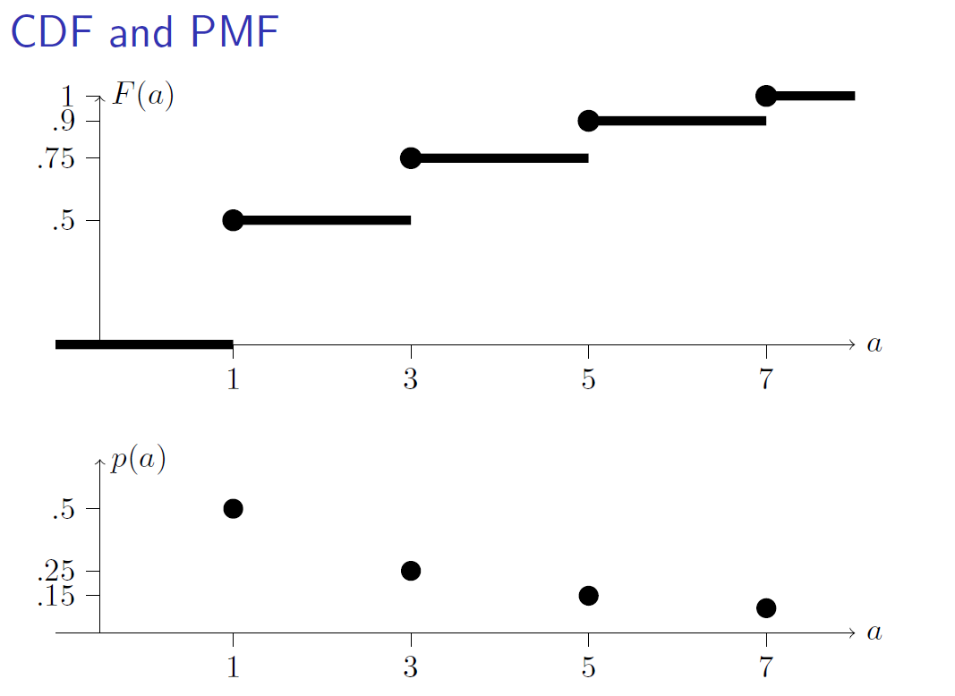

Slide 7
Question
Experiment: Toss a fair coin
Outcomes: H, T
Random variable (function from outcome to real number) X = 1 if H, 0 if T.
Event “X=1” denotes the {ω=H}.
What is P(X=1)?
P(X=1) = P(ω=H) = 1/2
Draw pmf and cdf.

Slide 8
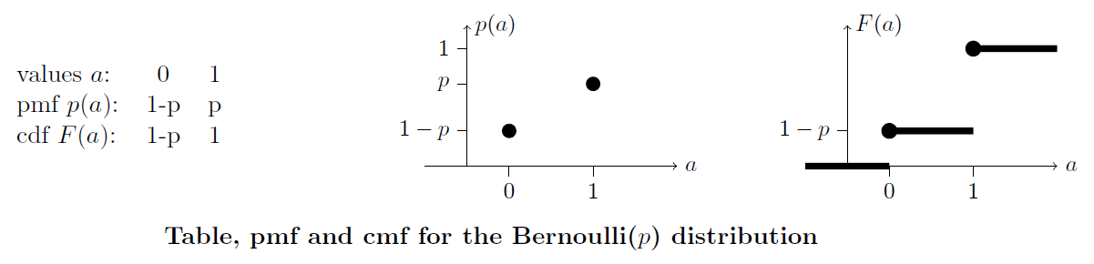
Specific Distributions
The Bernoulli distribution models one trial in an experiment that can result in either head or tail.
Bernoulli(p) = 1 (heads) with probability p, 0 (tails) with probability 1 − p.
1. X takes the values 0 and 1.
2. P(X = 1) = p and P(X = 0) = 1 − p.

Slide 9
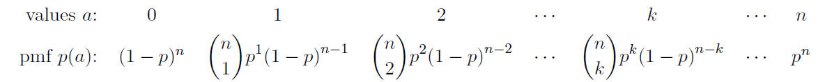
Specific Distributions
Binomial(n,p) = # of heads in n independent Bernoulli(p) trials.
Geometric(p) = # of tails before first heads in a sequence of independent Bernoulli(p) trials.
Uniform(N): The uniform distribution models any situation where all the outcomes are equally likely.
X takes values 1, 2, 3,...,N, each with probability 1/N.

Slide 10
Arithmetic of RVs
Toss a fair coin n times. Let Xj be 1 if the j_{th} toss is heads and 0 if it’s tails.
Xj is a Bernoulli(1/2) random variable.
Let X be the total number of heads in the n tosses. Assuming the tosses are independence we know X ∼ binomial(n, 1/2). We can also write
X = X1 + X2 + X3 + ... + Xn.
The sum is exactly the number of Xj that are 1, i.e. the number of heads.
The important thing to see in the example above is that we’ve written the more complicated binomial random variable X as the sum of extremely simple random variables Xj .
This will allow us to manipulate RVs algebraically.

Slide 11
Independent RVs
Definition: The discrete random variables X and Y are independent if
P(X = a, Y = b)= P(X = a)P(Y = b),
for any values a, b.

Slide 12
Questions
1. Let X ∼ binom(n, p) and Y ∼ binom(m, p) be independent. Then X + Y follows:
(a) binom(n + m, p) (b) binom(nm, p)
(c) binom(n + m, 2p) (d) other
2. Let X ∼ binom(n, p) and Z ∼ binom(n, q) be independent. Then X + Z follows:
(a) binom(n, p + q) (b) binom(n, pq)
(c) binom(2n, p + q) (d) other

Slide 13
Question
X = number of H before the second T of a sequence of independent Bernoulli(p) trials.
Find the pmf of X.
Hint:
Substitute X with a number 0, 1, 2, …
For example, {X=2}={ ---T} = {HHTT, HTHT, THHT}. 3C1 combinations for placing T in three positions → 3C1 such outcomes. Probability of getting each outcome is p²(1-p)².
Thus P(X=2)=3p²(1-p)².
Generalize to {X=n}.

Slide 14
Question
Show that the Geometric(p) is “memoryless”, i.e. P(X = n + k | X ≥ n)= P(X = k) .
Hint:
Geometric(p) = p (1-p)^{n-1}
Use events A = {X = n+k}, B={X ≥ n}
Try to show P(A|B)=P(X=k).

Slide 15

Expected value
Definition: Suppose X is a discrete random variable that takes values x1, x2, ..., xn with probabilities p(x1), p(x2), ..., p(xn).
The expected value of X is denoted E(X) and defined by
Notes:
1. The expected value is also called the mean or average of X and often denoted by μ (“mu”).
2. The expected value need not be a possible value of the random variable.
3. Expected value is a summary statistic, providing a measure of the location or central tendency of a random variable.
4. If all the values are equally probable then the expected value is just the usual average of the values.

Slide 16
Properties of E(X)
E(X + Y) = E(X) + E(Y) (linearity I)
E(aX + b) = aE(X) + b (linearity II)
E(h(X)) = ∑_{i} h(xi) p(xi)

Slide 17
Example
1. Let X be a Bernoulli(p) random variable. Find E(X).
X takes values 1 and 0 with probabilities p and 1 − p, so
E(X) = p · 1 + (1 − p) · 0 = p.
2. Suppose X ∼ Binomial(12,.25). Find E(X).
X = X1 + X2 + ... + X12, where Xi ∼ Bernoulli(.25). Therefore E(X)= E(X1)+ E(X2)+ ... E(X12) = 12 · (.25) = 3
In general if X ∼ Binomial(n, p) then E(X)= np.

Slide 18
Question
Let X be the value of a roll of one die and let Y = X². Find E(Y) (just give the formula).
Hint: E(Y) = E(X²)

Slide 19
Question
n people have seated. They are randomly replaced.
What is the expected number of people who returned to their original seat?
Hint:
Let X be the number of people returned to their original seat.
Number the people from 1 to n.
Let Xi be the Bernoulli random variable with value 1 if person i returns to their original seat and value 0 otherwise. Xi~Bernoulli(1/n)
Then X=X1+X2+X3+Xn.
Note that Xi and Xj are not independent.

